Slide 1
QUANTITATIVE ANALYSISMOF ORGANIC COMPOUNDS

Slide 2
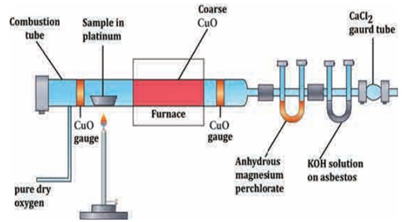
ESTIMATION OF CARBON AND HYDROGEN

Slide 3
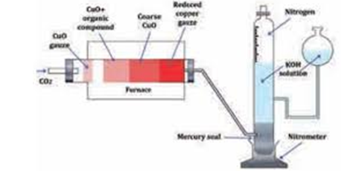
ESTIMATION OF NITROGEN
DUMAS METHOD

Slide 4
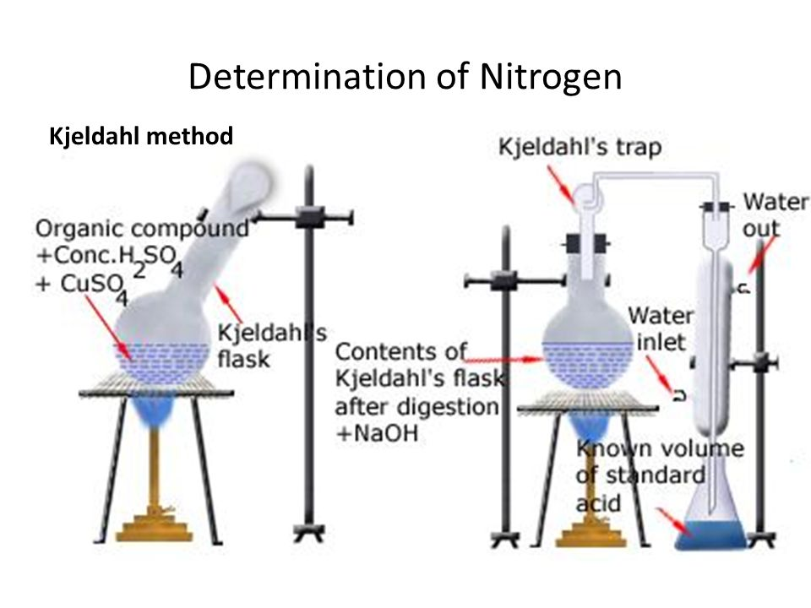

Slide 5
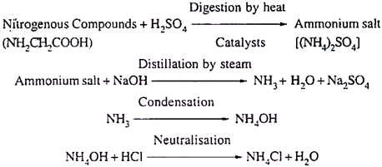
CALCULATION

Slide 7
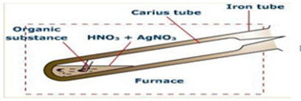
ESTIMATION OF SULPHUR

Slide 9
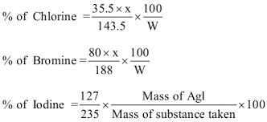
ESTIMATION OF HALOGENS

